Slide 1
KYC in CRM 10.2.x
Bharti Sharma

Slide 2
Introduction
KYC - Know Your Customer or Know Your Client is the regulatory process in which a financial institution verifies a customer’s identity by assessing their credentials before allowing them to use a service.
A 'Customer' is defined as a person or entity that maintains an account and/or has a business relationship with the bank.
The objective of KYC is to prevent banks from being used by criminal elements for money laundering activities.
KYC policies allow companies to better understand their customers and their customers’ financial dealings, which helps to effectively mitigate and manage risks prudently.
Finacle’s Customer Relationship Management application caters to the requirement of maintaining the KYC related details such as customer information, Risk rating, KYC done date and Next KYC date.
In CRM, KYC of a customer can be done by editing a customer and submitting for KYC. Such KYC exercise may include all measures for confirming the identity, address and other particulars of the customer that the bank/Financial Institute may consider reasonable and necessary based on the risk profile of the customer.

Slide 3
KYC Timelines
RBI “KYC” guidelines require Risk classification of accounts under “High Risk”, “Medium Risk” and “Low Risk” depending on the risk factors underlying customer profile.
Risk Rating | Re KYC
High | 2 Years
Medium | 8 Years
Low | 10 Years

Slide 4
KYC Configuration
Properties Setup
Process Setup
Selector Setup

Slide 5
Properties Set-up
The configuration of number of months after which KYC is due is maintained in Finacle in a properties file (KYC.properties).
KYC.properties contains the Risk Ratings and corresponding timelines for KYC due date.
Path: FinacleCRM.ear/FinacleCRM.war/properties

Slide 6
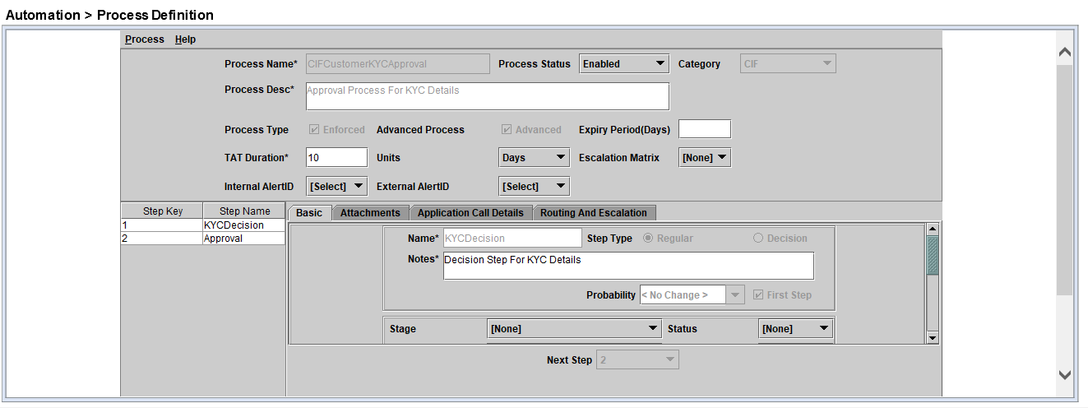
Process Set-up
KYC Approval requires a KYC related process to be enabled in the application.
On submitting a CIF for KYC, process selection functionality searches for a KYC related process in the application and assign the process to the CIF on saving the process selection window.
KYC process generally has 2 steps:
KYC Approval
Approval

Slide 7
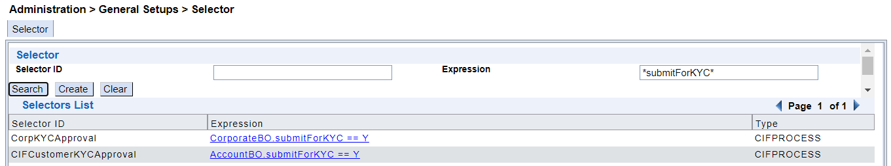
Selector Set-up
A selector enables the application to decide which process to assign to a particular CIF based on different conditions.
For KYC, there should be a selector with condition BOName.submitForKYC==Y
Different selectors should be available for each type of entity

Slide 8
KYC of Customer

Slide 9
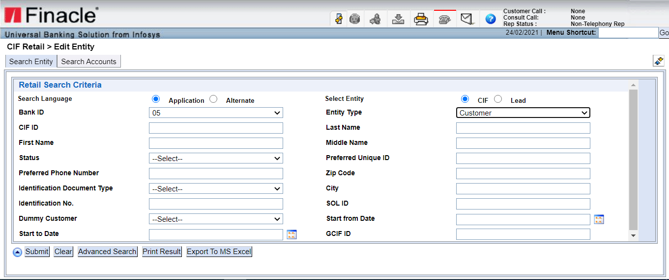

Slide 10
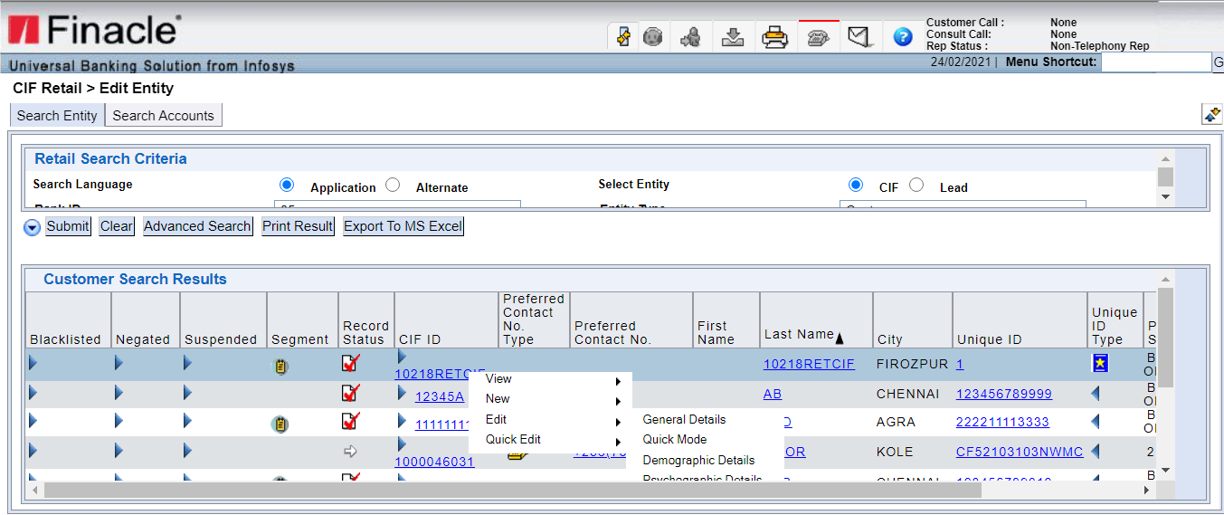

Slide 11
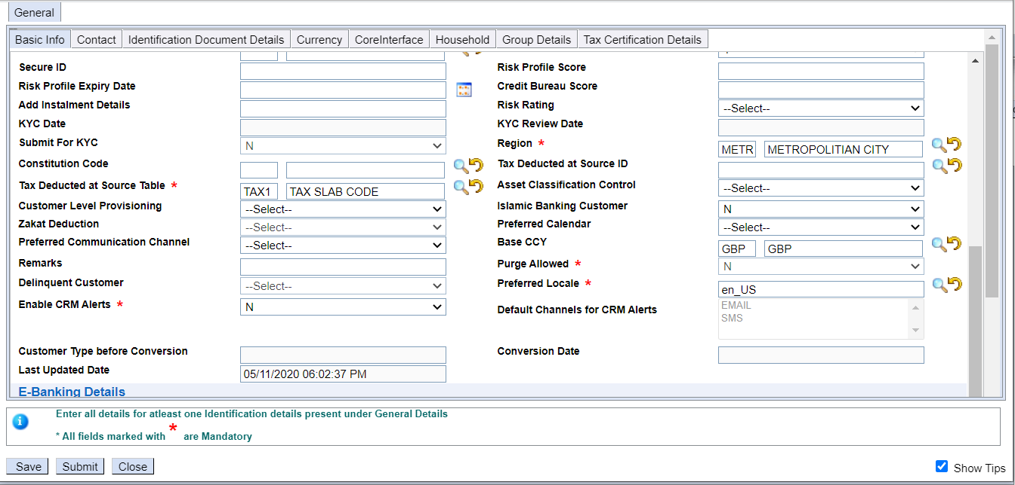

Slide 12
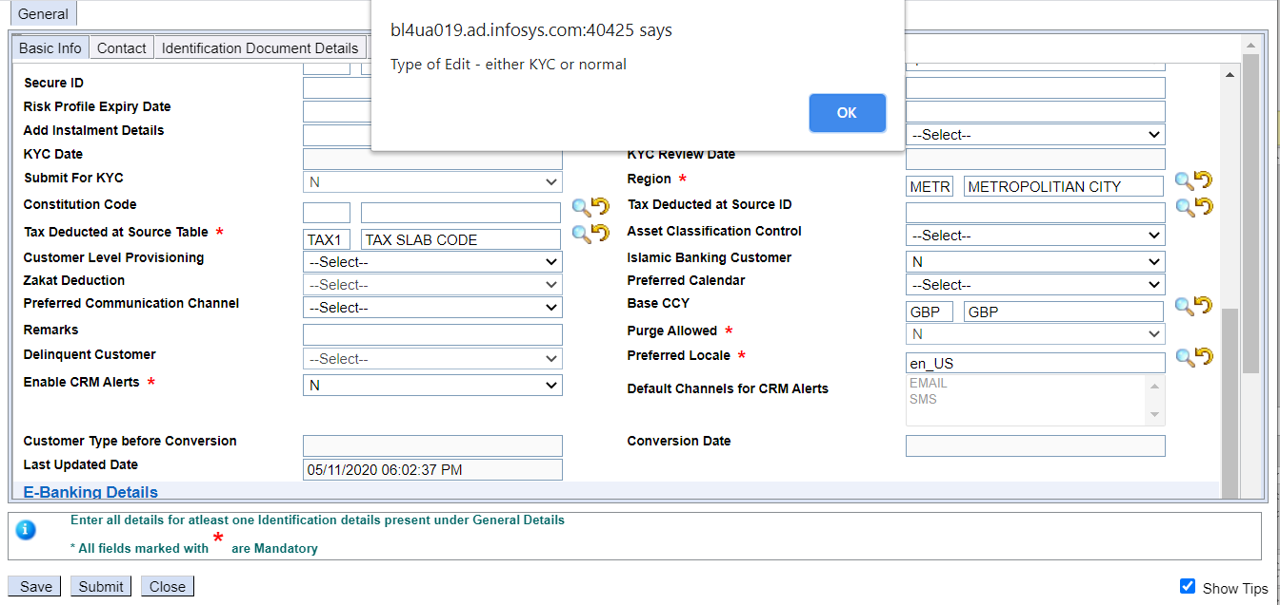

Slide 13
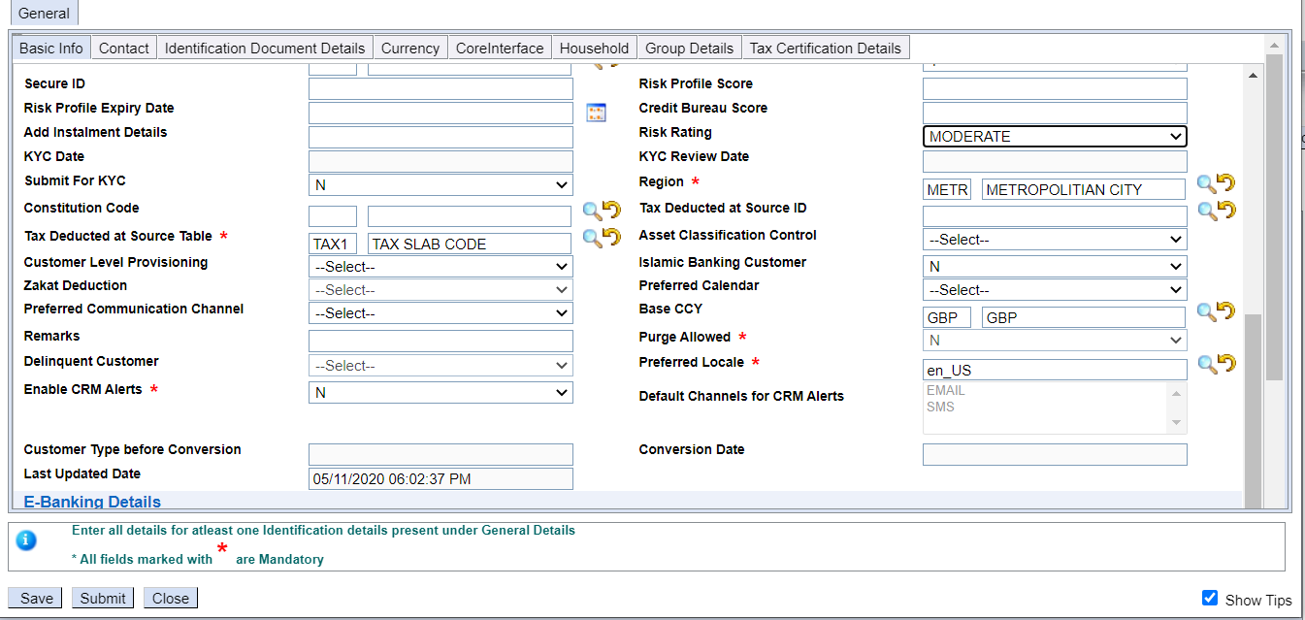

Slide 14
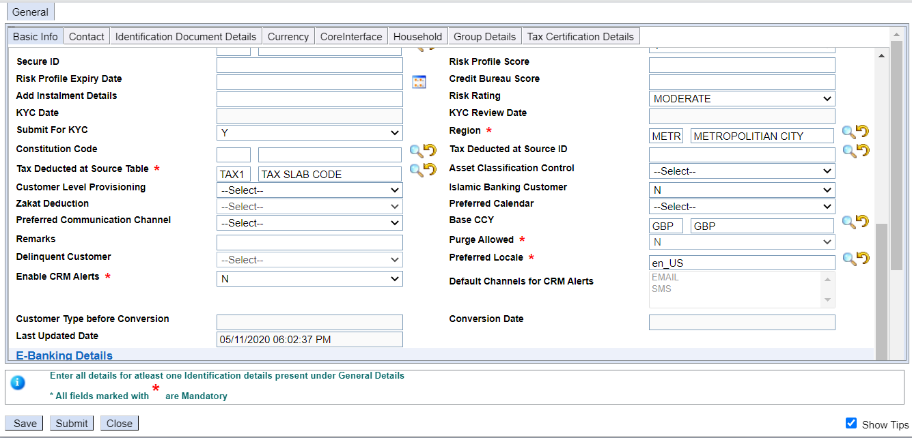

Slide 15
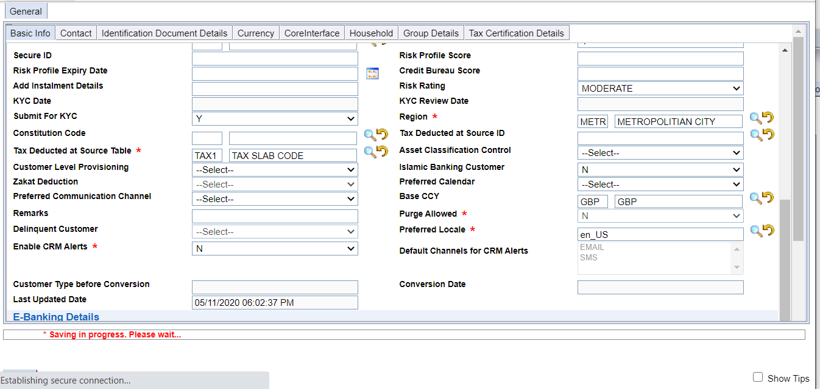

Slide 16
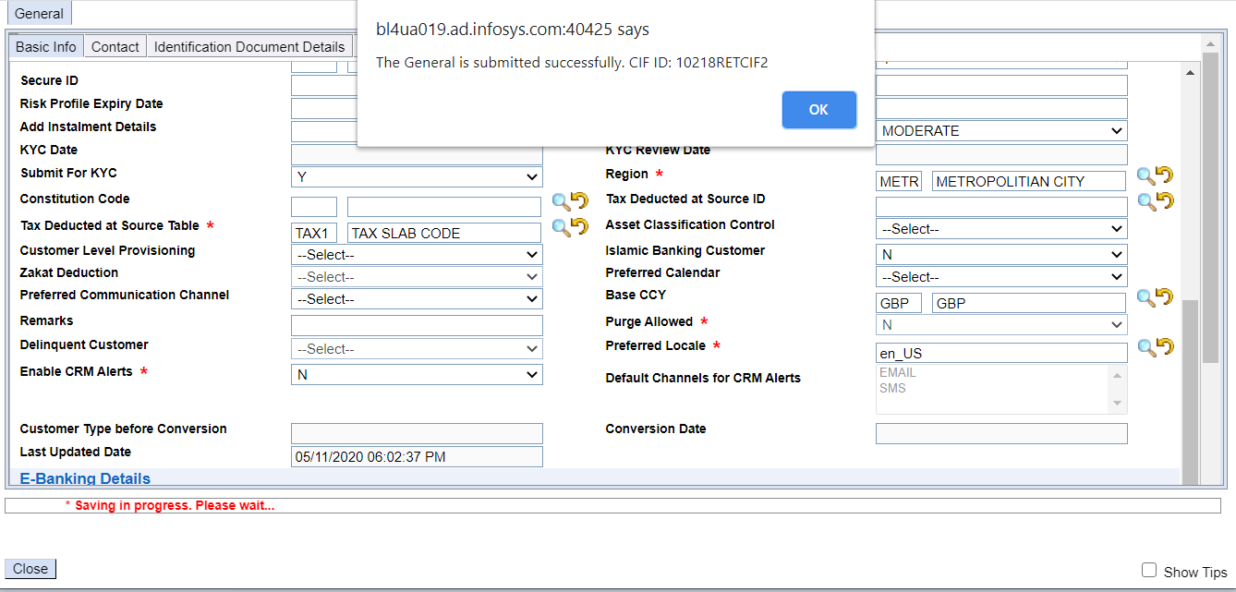

Slide 17
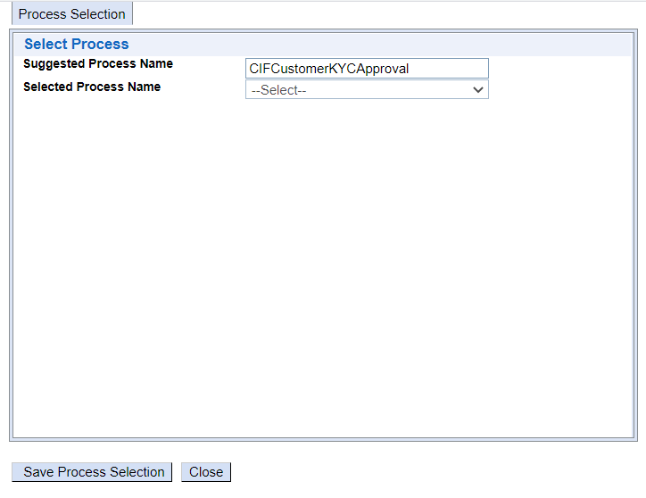

Slide 18
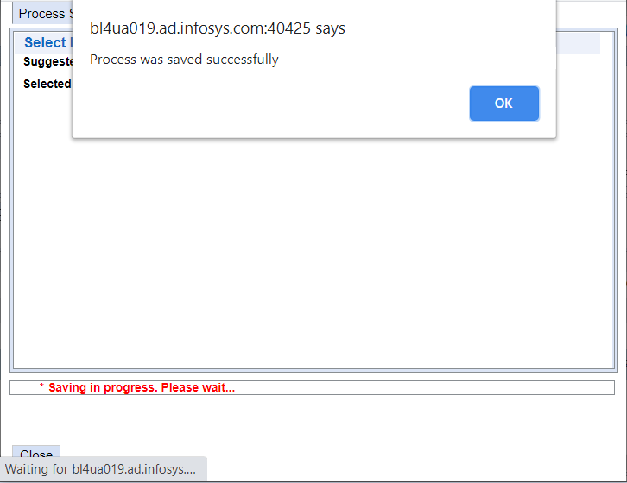

Slide 19
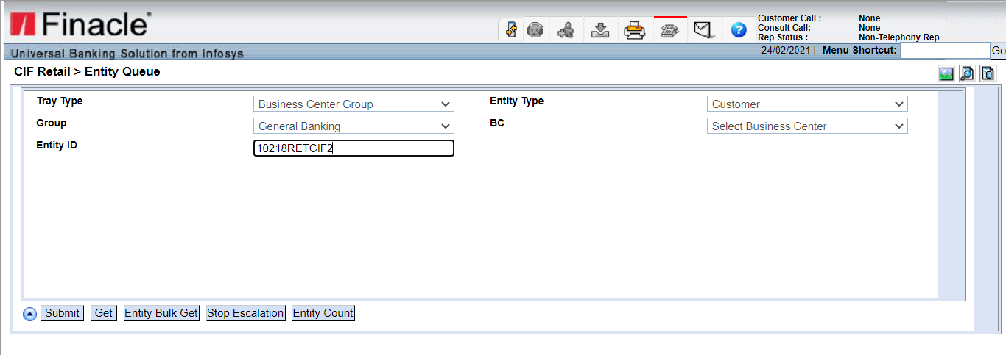

Slide 20
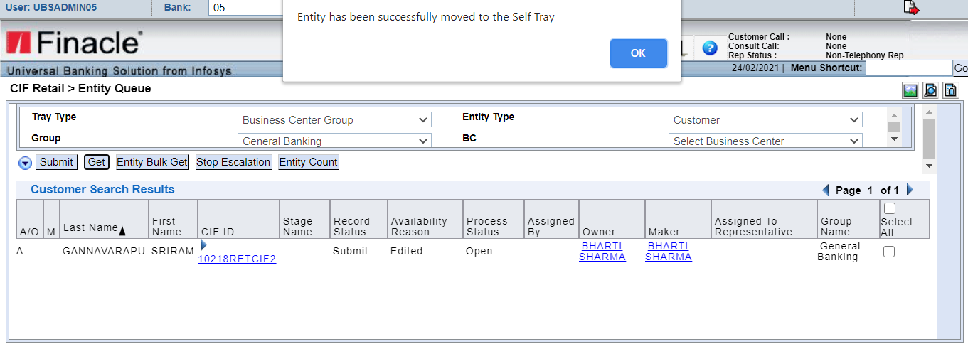

Slide 21
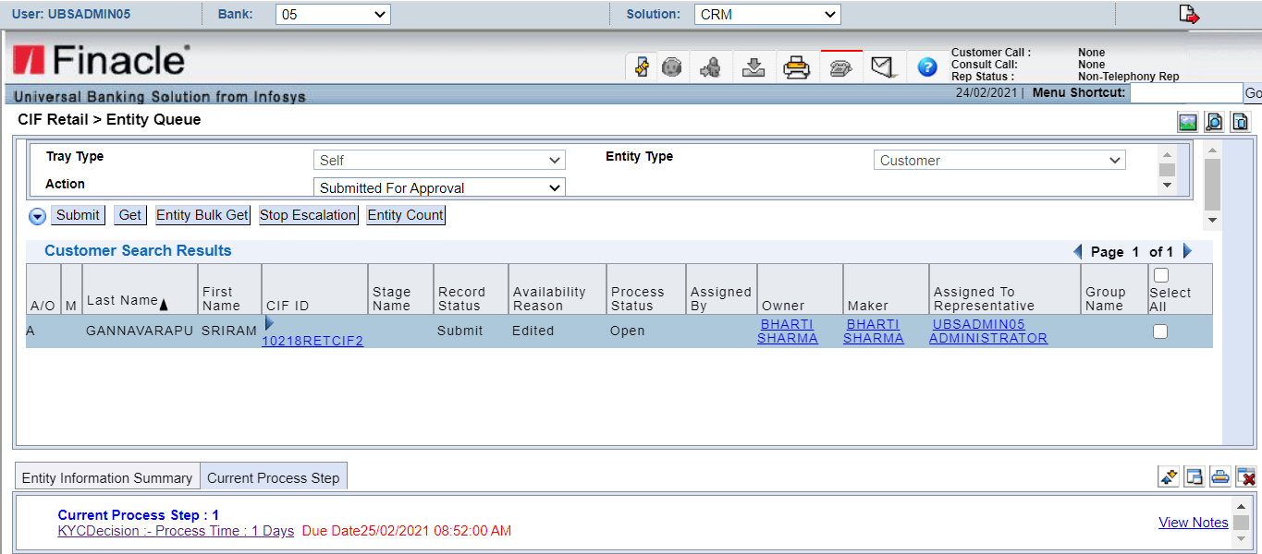

Slide 22
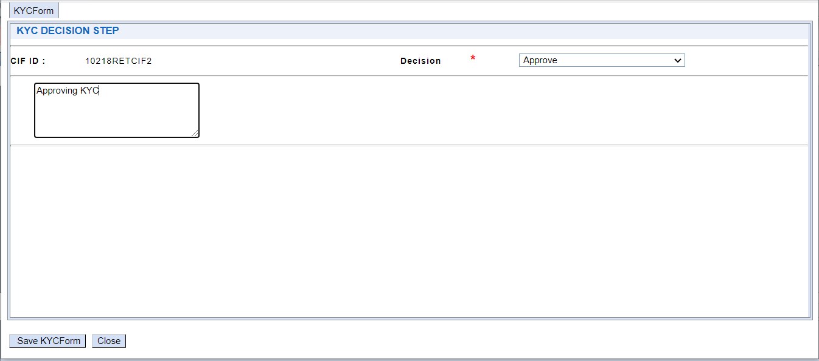

Slide 23
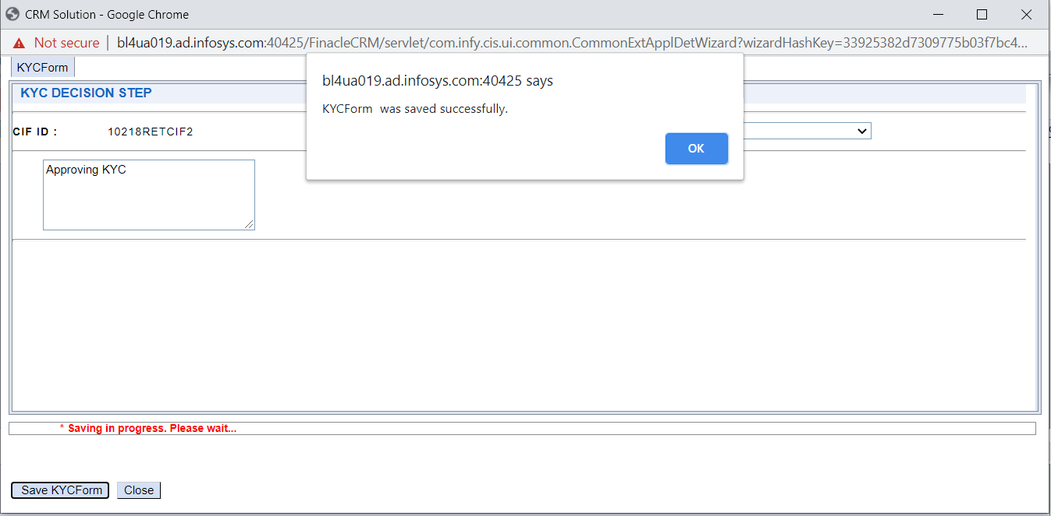

Slide 24
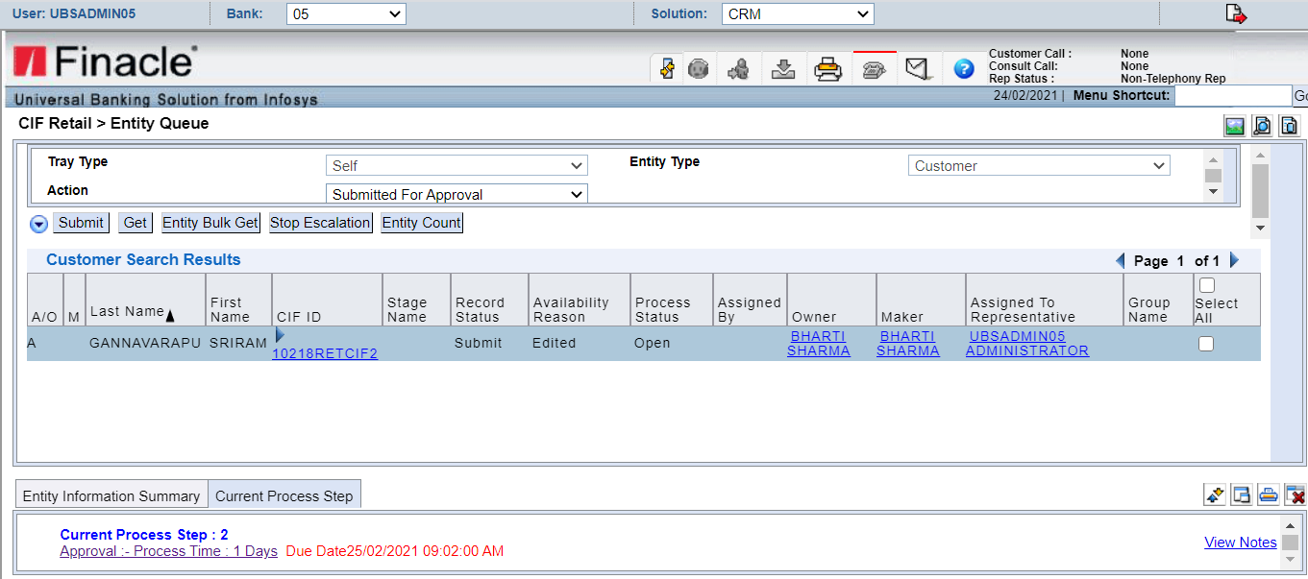

Slide 25
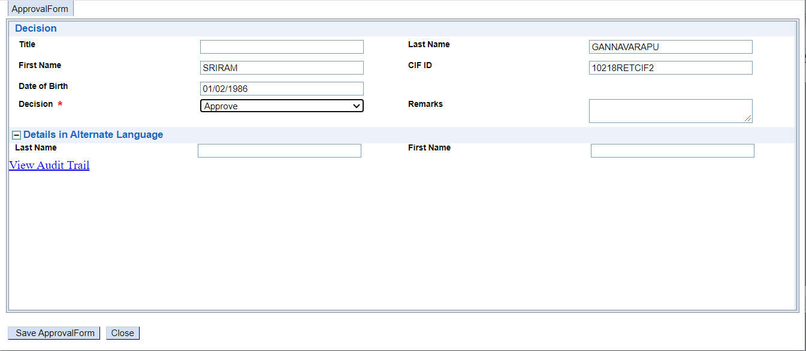

Slide 26
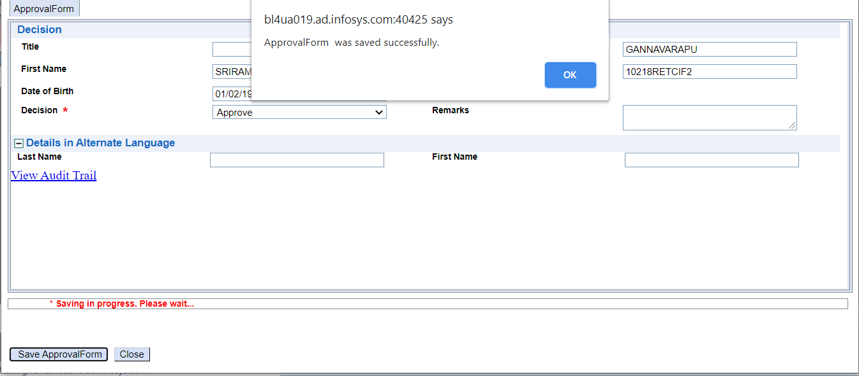

Slide 27
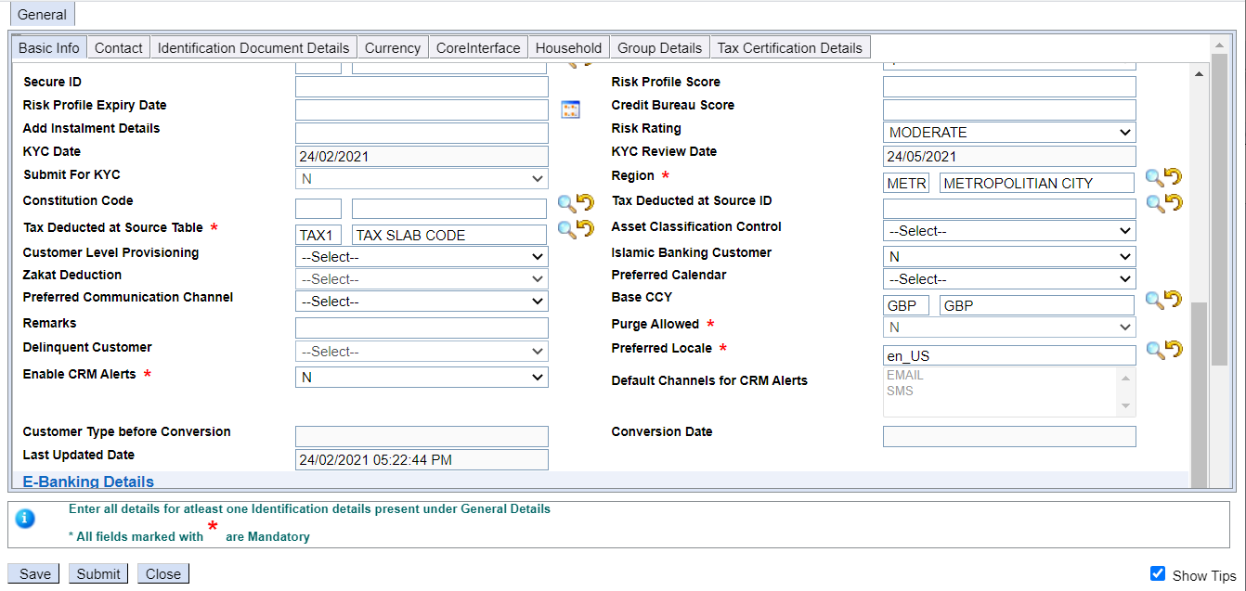

Slide 31
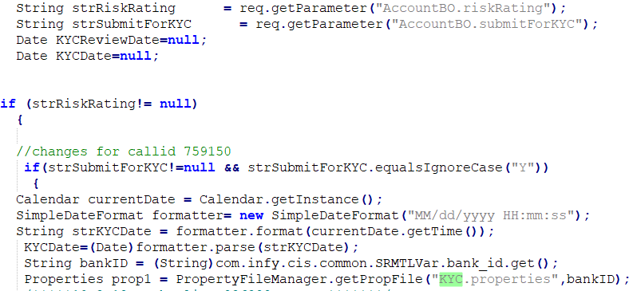
AccWriter.java and AccModHelper.java
A

Slide 32
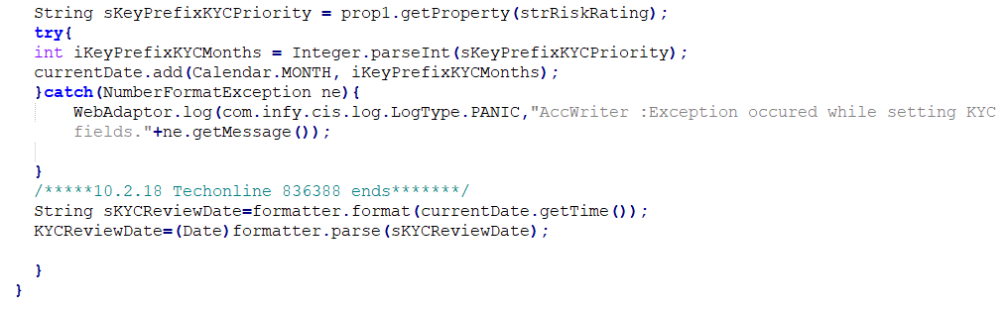

Slide 33
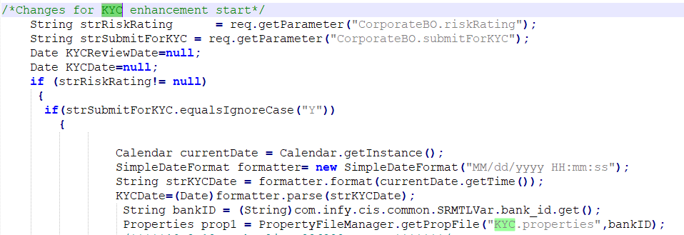
CorpGenWriter.java and CorpModGenWriter.java

Slide 34
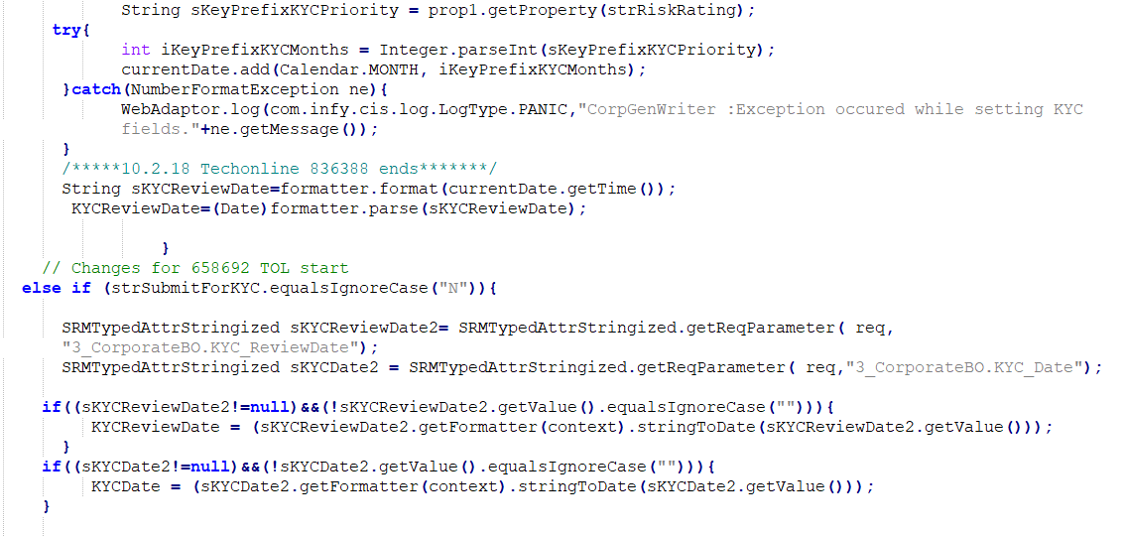

Slide 35
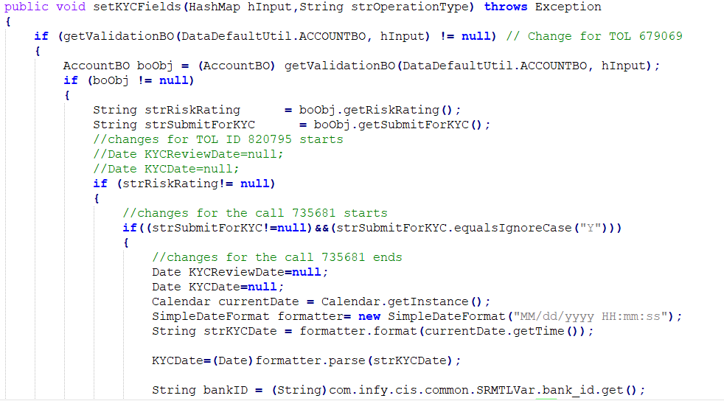
DataDefForRetailCust.java

Slide 36
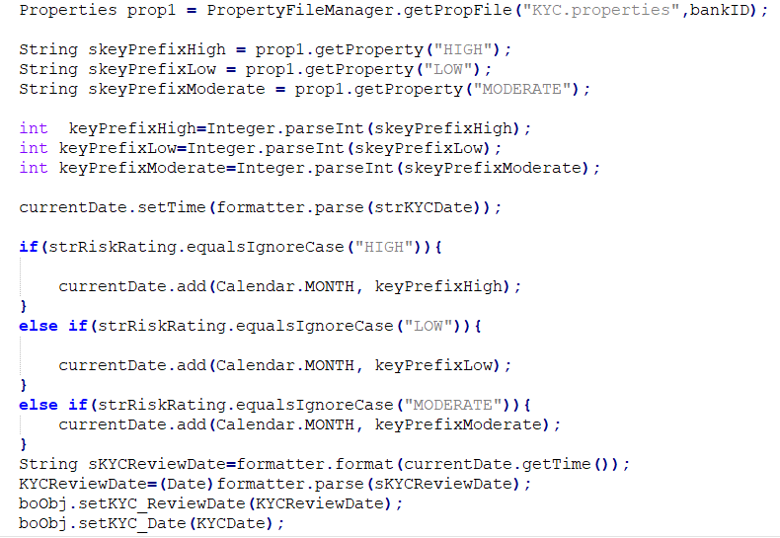

Slide 37
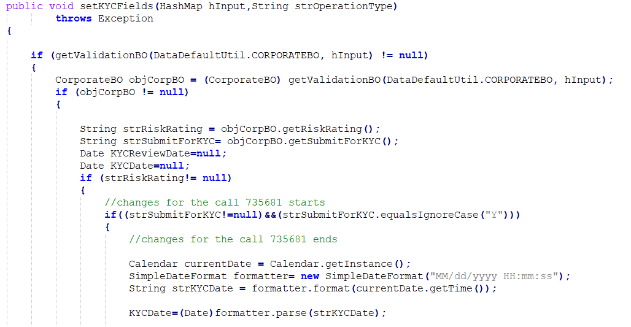
DataDefForCorpCust.java

Slide 38
